Slide 1
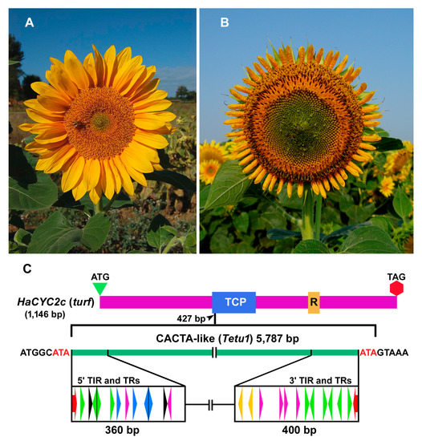
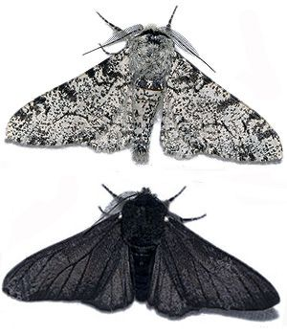
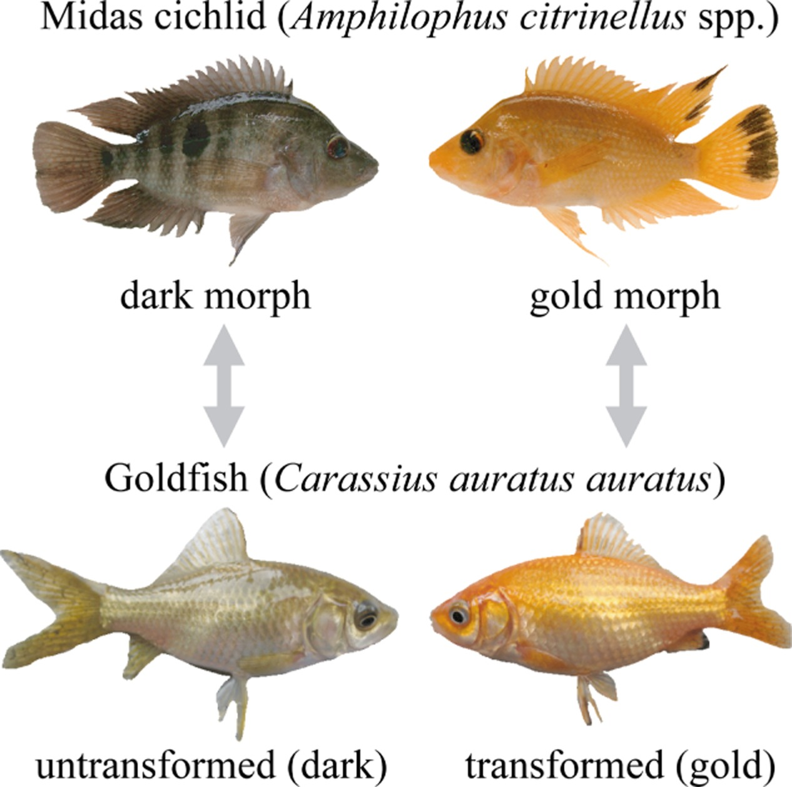
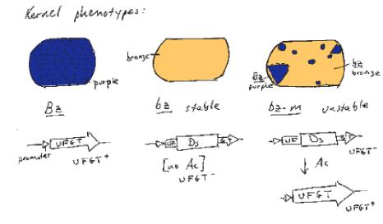
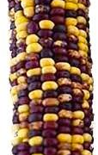

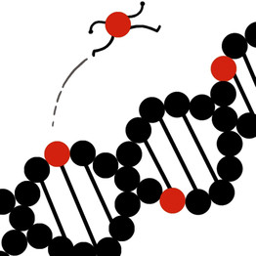
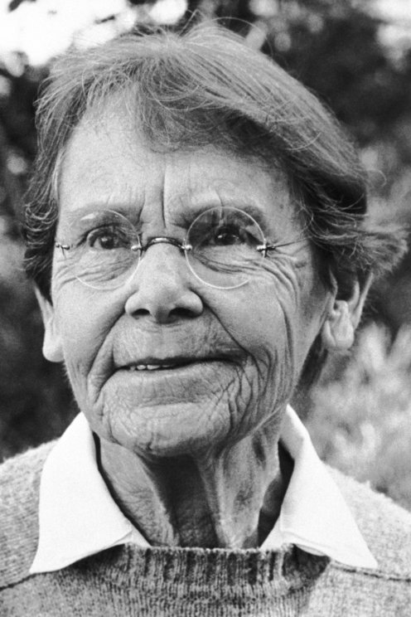
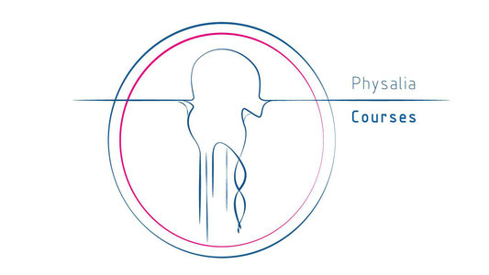
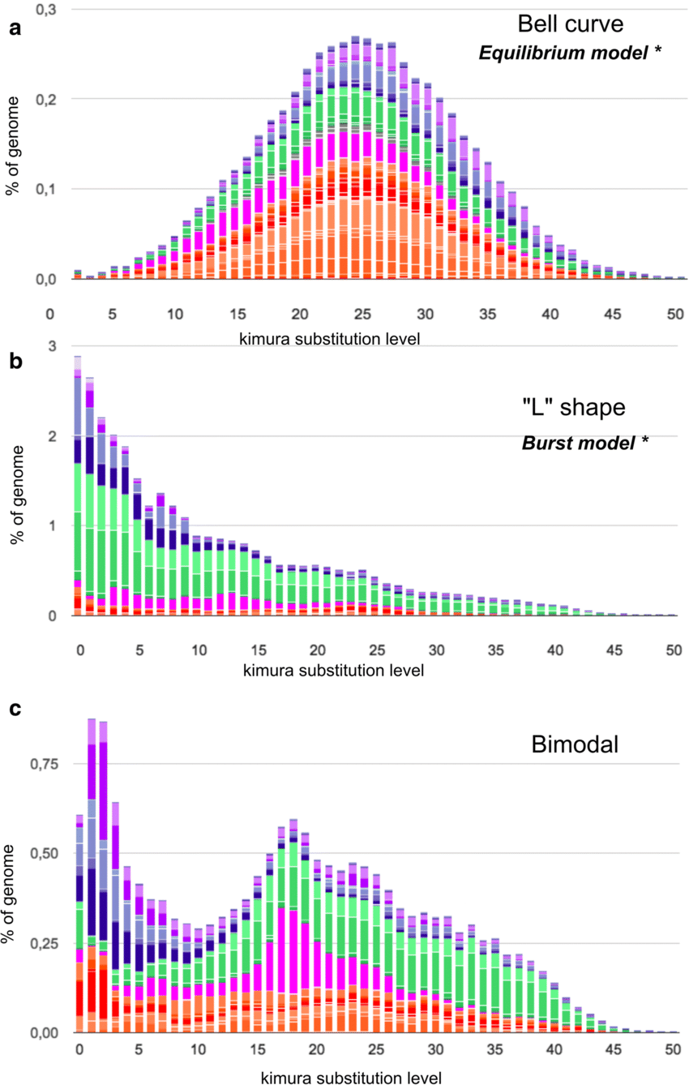
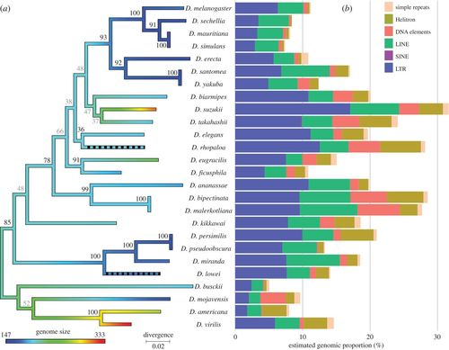
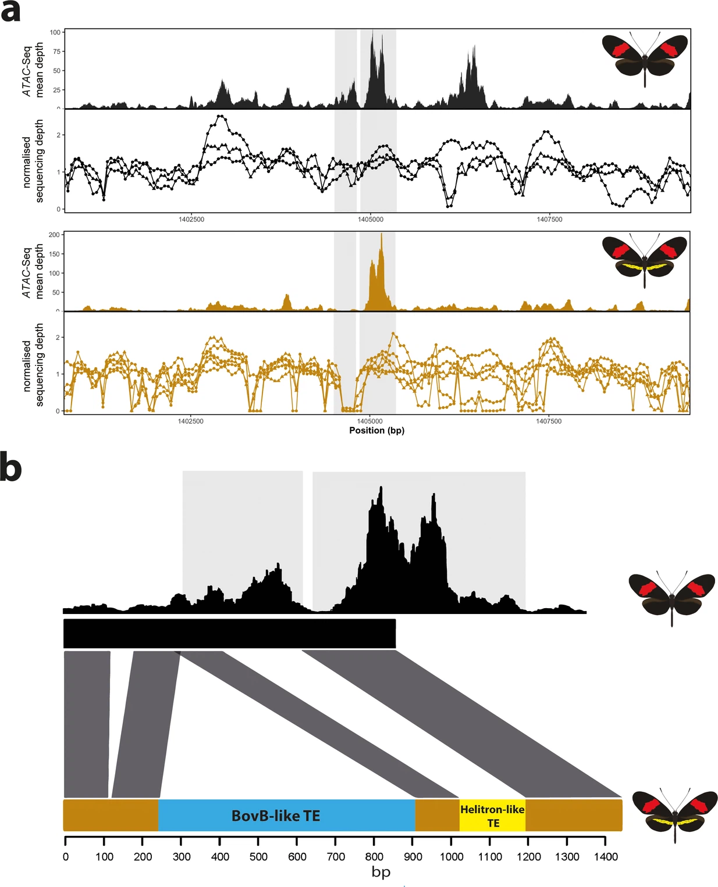



BIOINFORMATIC ANALYSIS OF TRANSPOSABLE ELEMENTS
3rd-7th November 2025
Lecture 1
TE diversity and mechanisms
Valentina Peona
Notes:
Same page – overview of the diversity

Slide 2
TE diversity
A FIELD GUIDE TO THE TEs OF THE WORLD

Slide 3
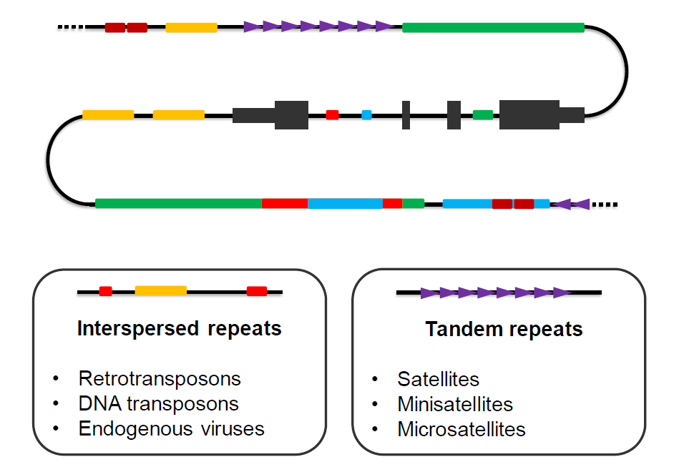
Genomes: DNA on repeats

Slide 4
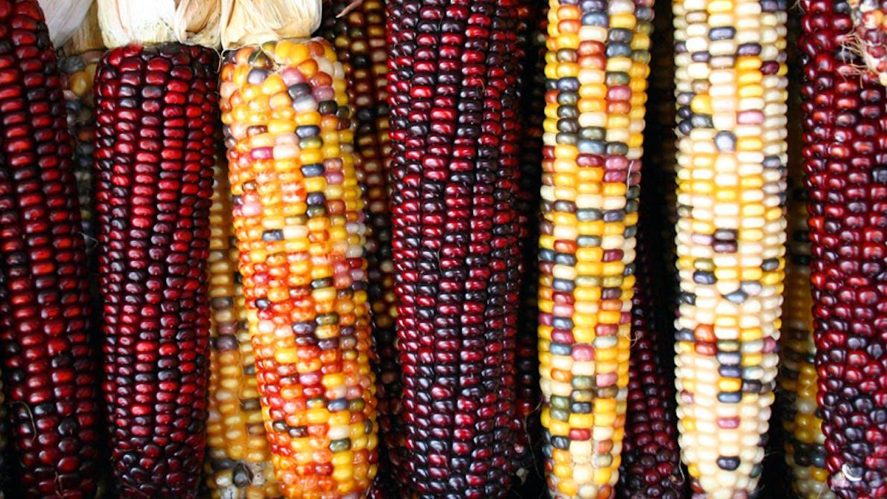
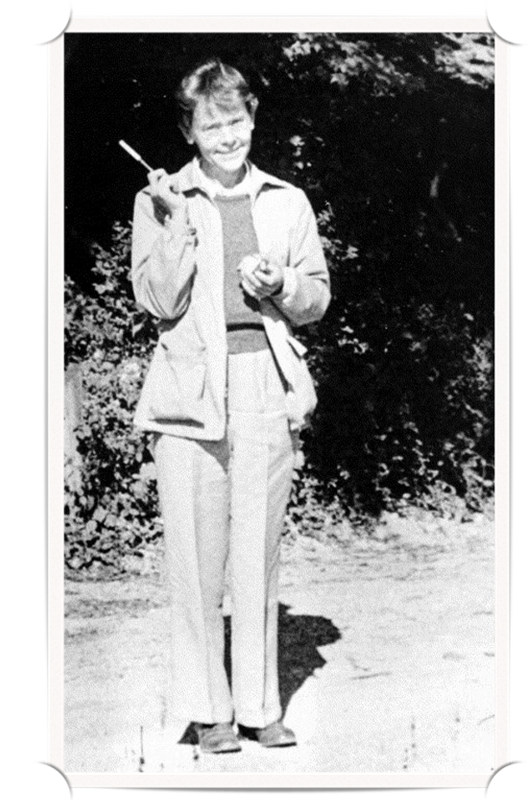
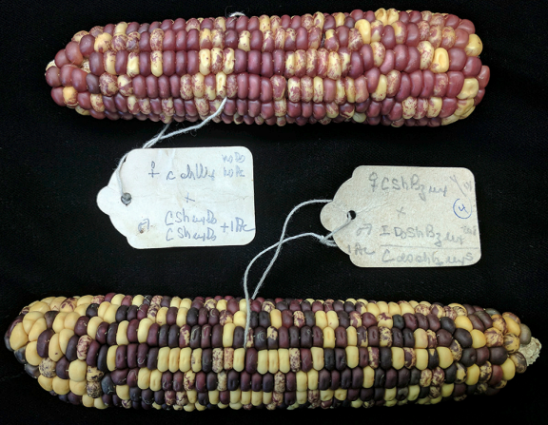
Barbara McClintock
Controlling elements
Nobel Prize
1983
Nobel Lecture
FELDMAN, Jacqueline. "A Feeling for the Organism, The Life and Work of Barbara MacClintock." (1992): 430-433.
Feschotte, C. Transposable elements: McClintock’s legacy revisited. Nat Rev Genet 24, 797–800 (2023). https://doi.org/10.1038/s41576-023-00652-3

Slide 5
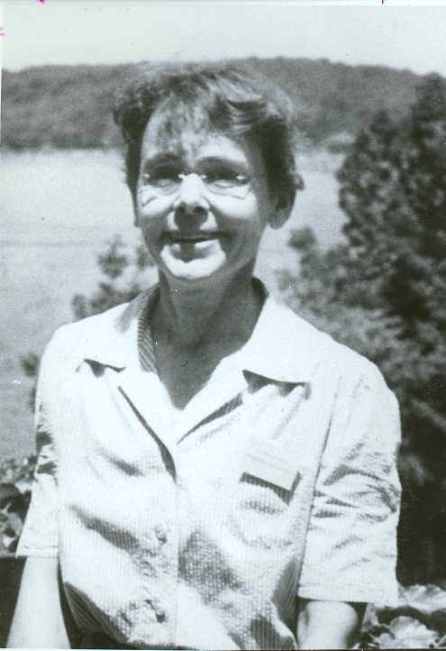
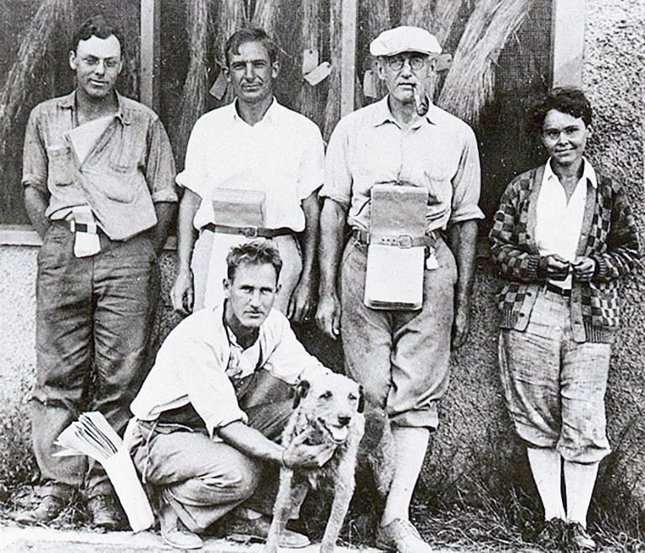
Plant Breeding Department at Cornell University in 1927
Barbara McClintock, 1951
Standing from left to right are Charles R. Burnham, Marcus M. Rhoades, Rollins A. Emerson, and Barbara McClintock. Kneeling is George Beadle. Image courtesy of Cold Spring Harbor Laboratory Archives, NY. CC BY-NC-SA

Slide 6
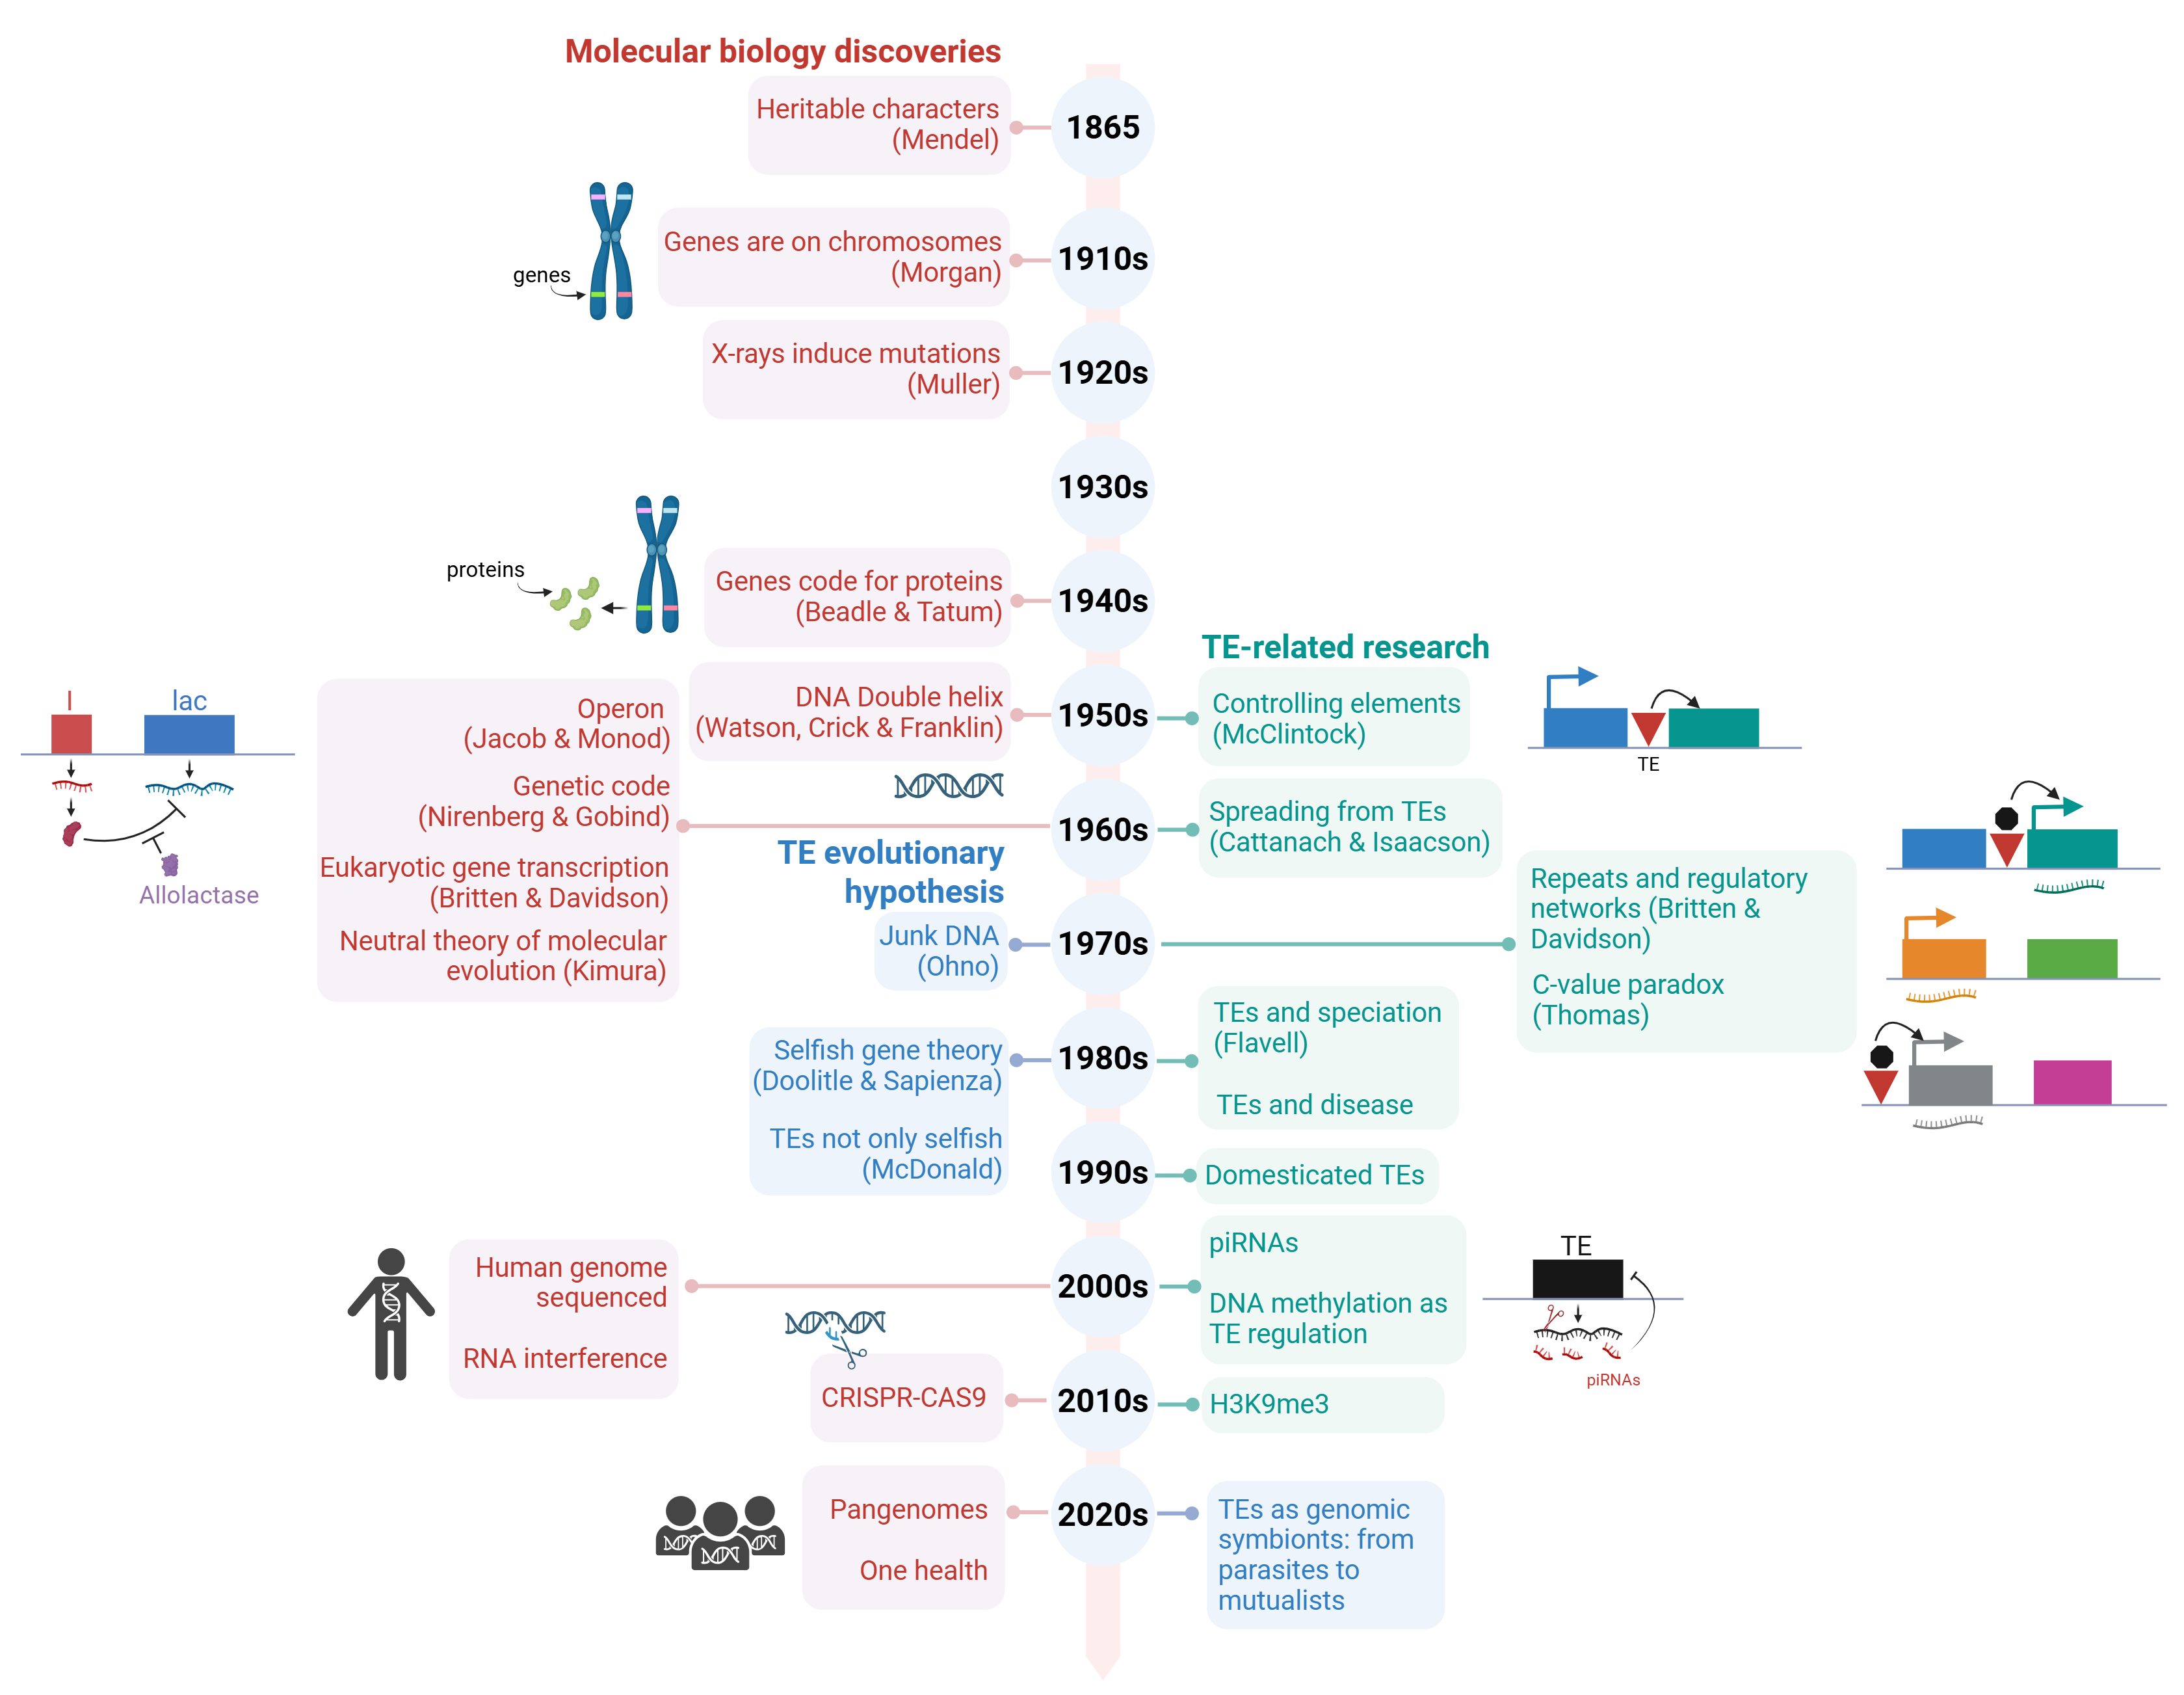
TE History
Slide by Rita Rebollo

Slide 7
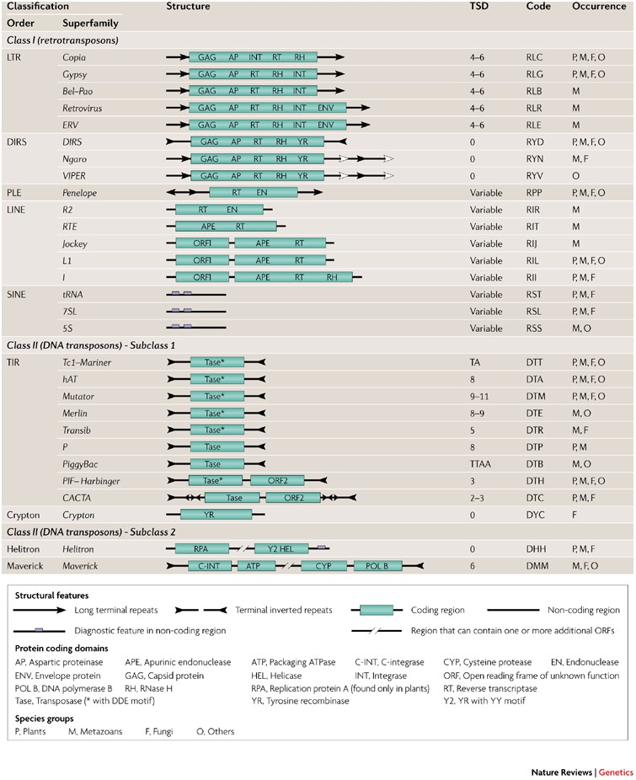

Eukaryotic transposable elements
&
&
Wicker et al 2007, Nat Rev Gen

Slide 8
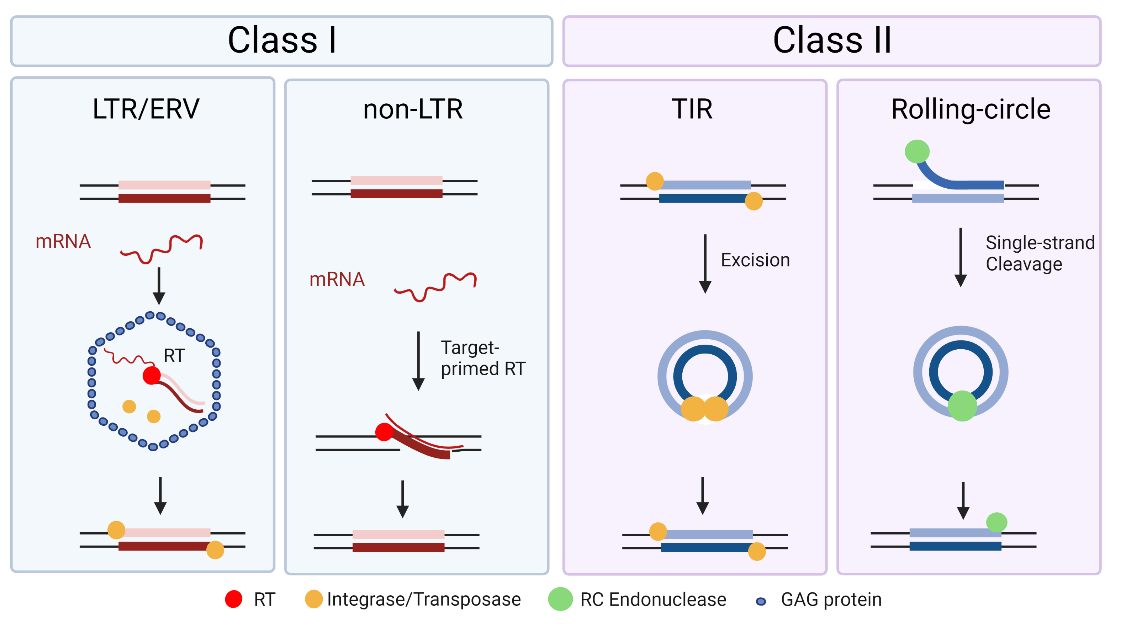
Eukaryotic transposable elements
&
&
Miriam Merenciano, Anaïs Larue, Cristian Groza, Cristina Vieira, Rita Rebollo, Clément Goubert (2024). Epigenetics and genotypic variation. In : On Epigenetics and Evolution. Elsevier, 119-151

Slide 9
Class I: LINE retrotransposons
RT - retrotranscriptase
EN - endonuclease
RH – RNAse H
APE - DNA (apurinic/apyrimidinic site) endonuclease
5’ UTR
ORF1
ORF2
Cis-mobilization!
3’ UTR
Promoter for
RNA polymerase
Open reading frame(s) for
transposition proteins
Recognition site for
reverse transcriptase
Wicker et al 2007, Nat Rev Gen

Slide 10
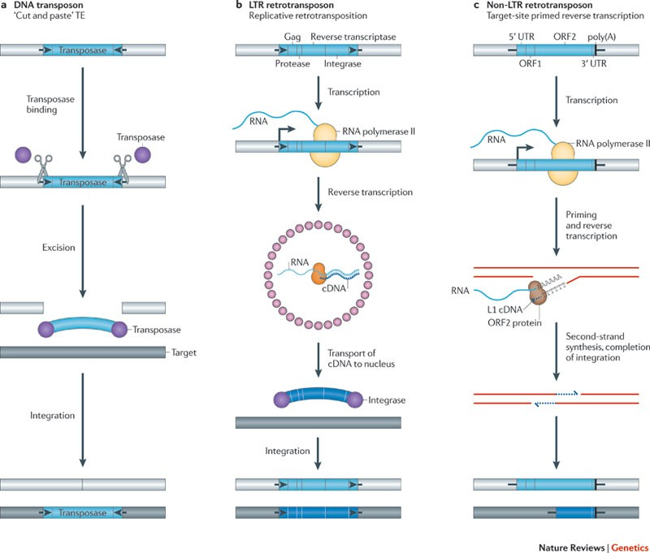
Target-primed reverse transcription (TPRT)
Cut with endonuclease
Priming with 3’ tail
Retrotranscriptase
UPDATE
George E. Ghanim et al. ,Structural mechanism of LINE-1 target-primed reverse transcription.Science388,eads8412(2025).
Priming and
reverse transcription
TPRT often undergoes premature 5’ truncation and loss of promoters and/or protein domains
Levin and Moran 2011, Nat Rev Gen

Slide 11
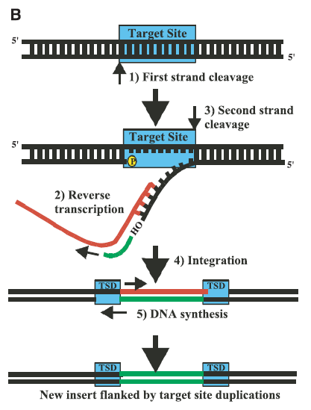
Target Site Duplication (TSD)
The length of TSDs is important for classification
The length is variable for LINEs but can be of specific lengths for other types of elements
TSDs are the hallmark of most (retro)transposons

Slide 12
Target site preferentiality
Priming and endonuclease cleavage site
Preferential target for L1 in humans:
5’-TTTTT/AA-3’
(Feng et al., 1996; Jurka, 1997)
Notes:
L1 integrates into genomic DNA by target-site primed reverse
transcription (TPRT) (Feng et al., 1996; Luan et al., 1993).
An apurinic/apyrimidinic endonuclease (APE)-like domain at
the ORF2p amino terminus (L1 EN) cleaves the degenerate
consensus sequence 5’-TTTT/AA-3’ to expose a 3’-OH group
(Feng et al., 1996; Jurka, 1997). Annealing between a short
stretch of genomic thymidine bases and the 3’ L1 poly(A) tract
establishes a primer/template structure that is used by the L1
reverse transcriptase (RT) to generate (-) strand L1 cDNA (Kulpa
and Moran, 2006; Monot et al., 2013). Subsequent steps likely
require L1 and host protein activities (Liu et al., 2018; Richardson
et al., 2015).

Slide 13
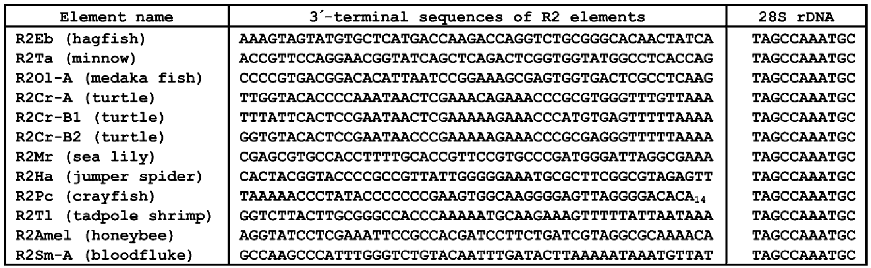
Target site preferentiality
The case of R2
R2 target site
TPRT can lead to insertion site preference or even specificity
Kojima & Fujiwara 2005, Mol. Biol. Evol.

Slide 14
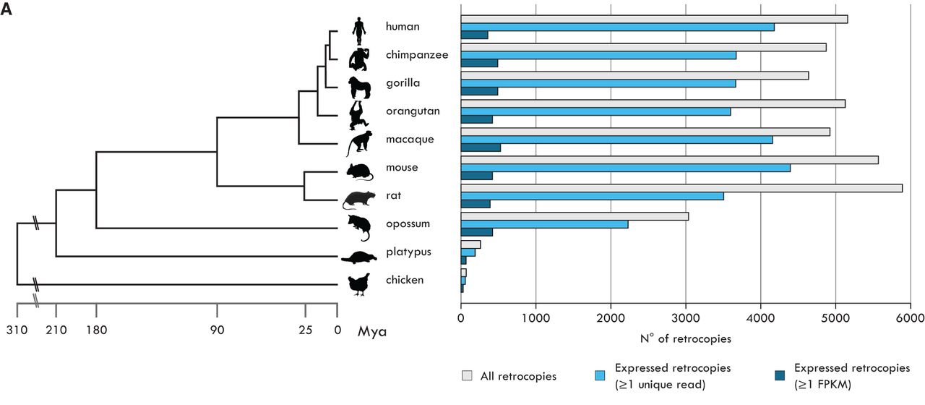
L1 and retro(pseudo)genes
5’ UTR
ORF1
ORF2
3’ UTR
Recognition site for RT
Retrogenes occur when LINE RT recognizes the poly-A tails (L1)
Carelli et al 2016, Gen Res

Slide 15
Class I: SINE retrotransposons
5’ UTR
ORF1
ORF2
3’ UTR
CR1
(ATTCTRTG)_{n}
TguSINE1
tRNA-like
CR1-like
Pol III promoter
(ATTCTRTG)_{n}
SINEs use the LINE protein machinery to move and replicate – trans-mobilization!
Non-autonomous elements
Wicker et al 2007, Nat Rev Gen

Slide 16
TE characteristics so far...
Promoter is necessary
Encode proteins and recognition motifs for their own mobilization
Transpositions leave signatures in the genome: target site duplications
Their particular mobilization can have different effects on genome evolution:
clustering (target site preferentiality)
trans-mobilization of other mRNAs (e.g., non-autonomous TEs and retrogenes)

Slide 17
Class I: LTR retrotransposons
GAG – capsid protein
AP – aspartic proteinase
RT - retrotranscriptase
RH – RNAse H
INT - integrase
ENV – envelope protein
LTR
LTR
Long Terminal Repeat
GAG AP RT RH INT (ENV)
Non-allelic homologous recombination (NAHR)
Full-length
Solo-LTR
Wicker et al 2007, Nat Rev Gen

Slide 18
Replicative retrotransposition
Retrotranscription inside a virus-like particle
Reverse transcription
Levin and Moran 2011, Nat Rev Gen

Slide 19
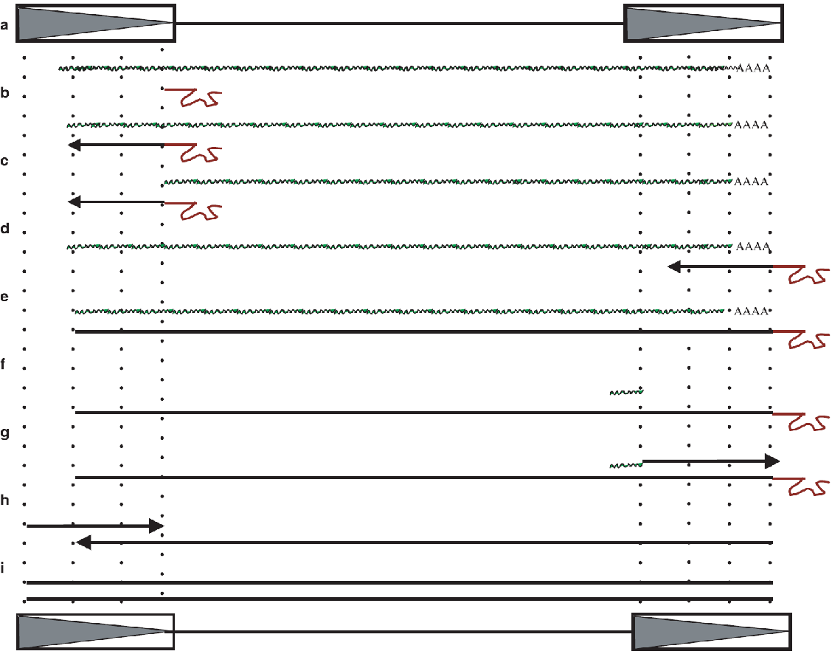
LTR are essential for retrotransposition
LTR
GAP AP RT RH INT (ENV)
LTR
Transcription starts from an internal promoter!
PBS PPT
(primer binding site) (polypurine tract)
Insertion in the genome
Transcribed LTR retrotransposon
tRNA primer
The synthesis of ds-DNA copy happens within the viral-like particle
PPT
The second LTR ensure the restoring of the entire element
Complete new copy ready to be integrated in the genome
Kazazian 2004, Science
Notes:
Retroviral RT has three sequential biochemical activities: RNA-dependent DNA polymerase activity, ribonuclease H (RNase H), and DNA-dependent DNA polymerase activity.

Slide 20
TE characteristics so far...
Promoter is necessary
Its integrity is essential!
Encode proteins and recognition motifs for their own mobilization
Transpositions leave signatures in the genome: target site duplications
Their particular mobilization can have different effects on genome evolution:
clustering (target site preferentiality)
trans-mobilization of other mRNAs (e.g., non-autonomous TEs and retrogenes)
trigger of non-allelic homologous (ectopic) recombination

Slide 21
Class II: DNA transposons
Tase – Transposase
TIR – Terminal Inverted Repeat
TIR
Transposase
TIR
Wicker et al 2007, Nat Rev Gen

Slide 22

Cut and paste transposition
Excision
Levin and Moran 2011, Nat Rev Gen

Slide 23
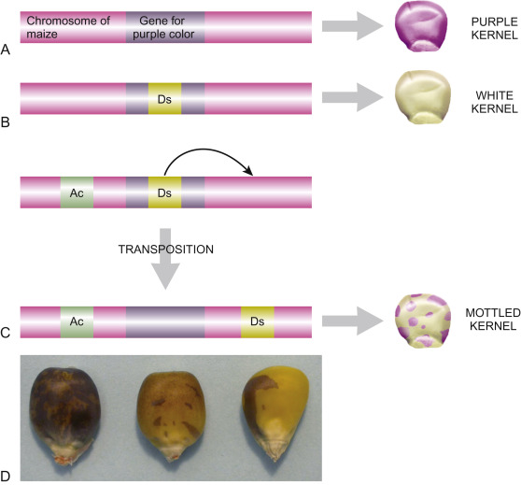
Ac/Ds transposons
hAT family
Ac – autonomous
Ds – non-autonomous
B. McClintock, The origin and behavior of mutable loci in maize, Proc. Natl. Acad. Sci. U.S.A. 36 (6) 344-355, https://doi.org/10.1073/pnas.36.6.344 (1950).

Slide 24
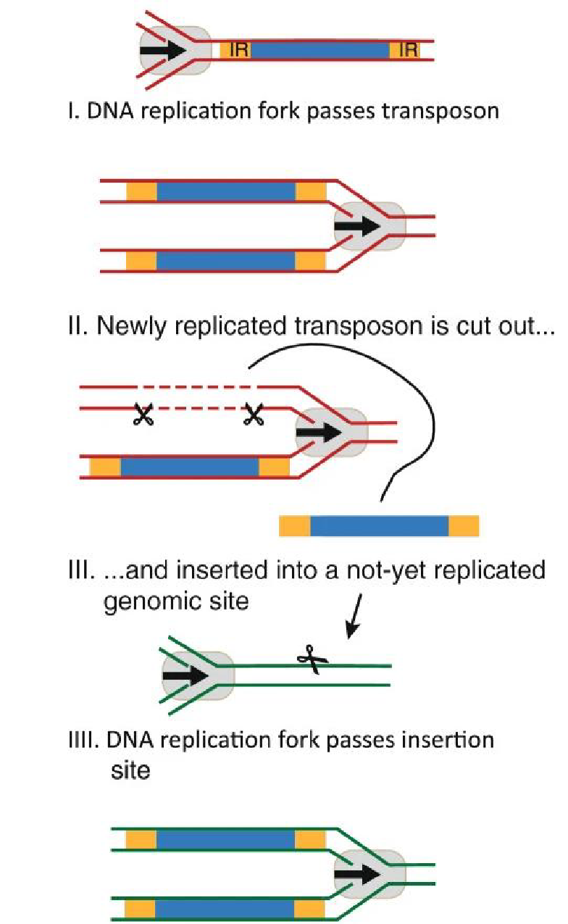
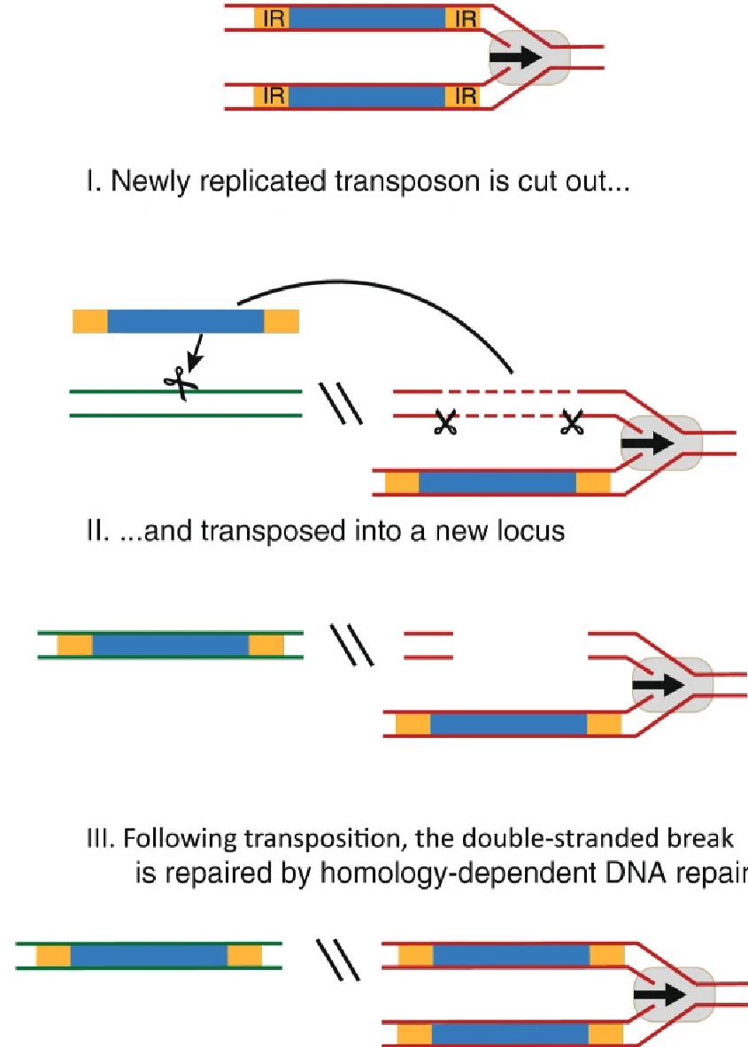
How to increase in copy number?
Skipper et al. 2013, J. Biomed. Sci.

Slide 25
TE characteristics so far...
Promoter is necessary
Its integrity is essential!
Encode proteins and recognition motifs for their own mobilization
Transpositions leave signatures in the genome: target site duplications
Their particular mobilization can have different effects on genome evolution:
clustering (target site preferentiality)
trans-mobilization of other mRNAs (e.g., non-autonomous TEs and retrogenes)
trigger of non-allelic homologous (ectopic) recombination
Excision-based transposition can also lead to increased copy number

Slide 26
Class II: DNA transposons (subclass 2)
&
Wicker et al 2007, Nat Rev Gen

Slide 27
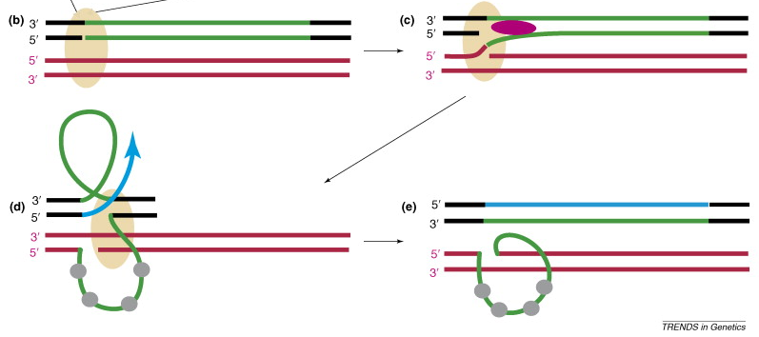
Rolling circle transposition: Helitrons
Replicase
Helicase
Replication Protein A (RPA)
Kapitonov and Jurka 2007, Trends Genet

Slide 28
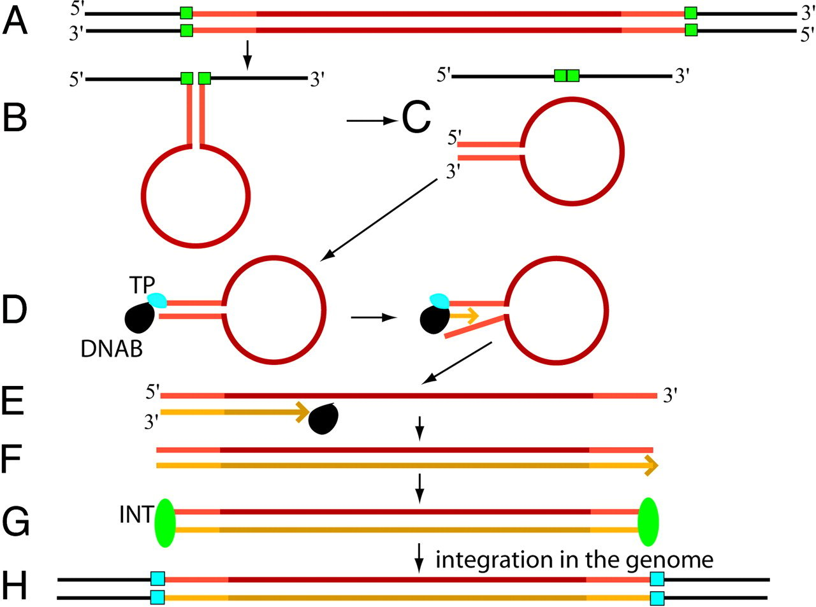
Self-synthesizing transposition: Mavericks/Polintons
DNAB – protein-primed type B DNA polymerase
TP – terminal protein
INT - integrase
Kapitonov and Jurka 2006, PNAS
Notes:
Polintons have evolved from a linear plasmid that acquired a retroviral integrase at least 1 billion years ago

Slide 29
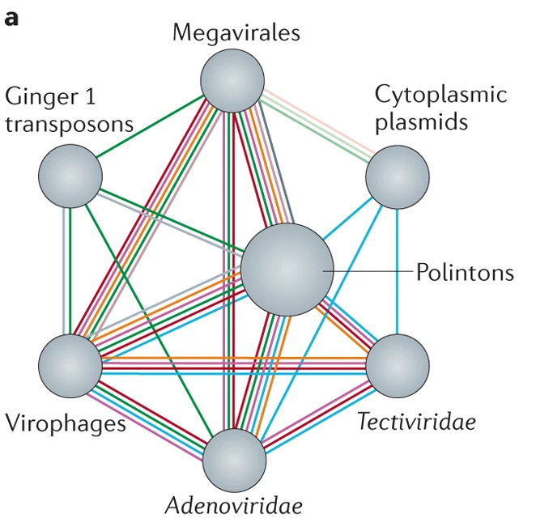
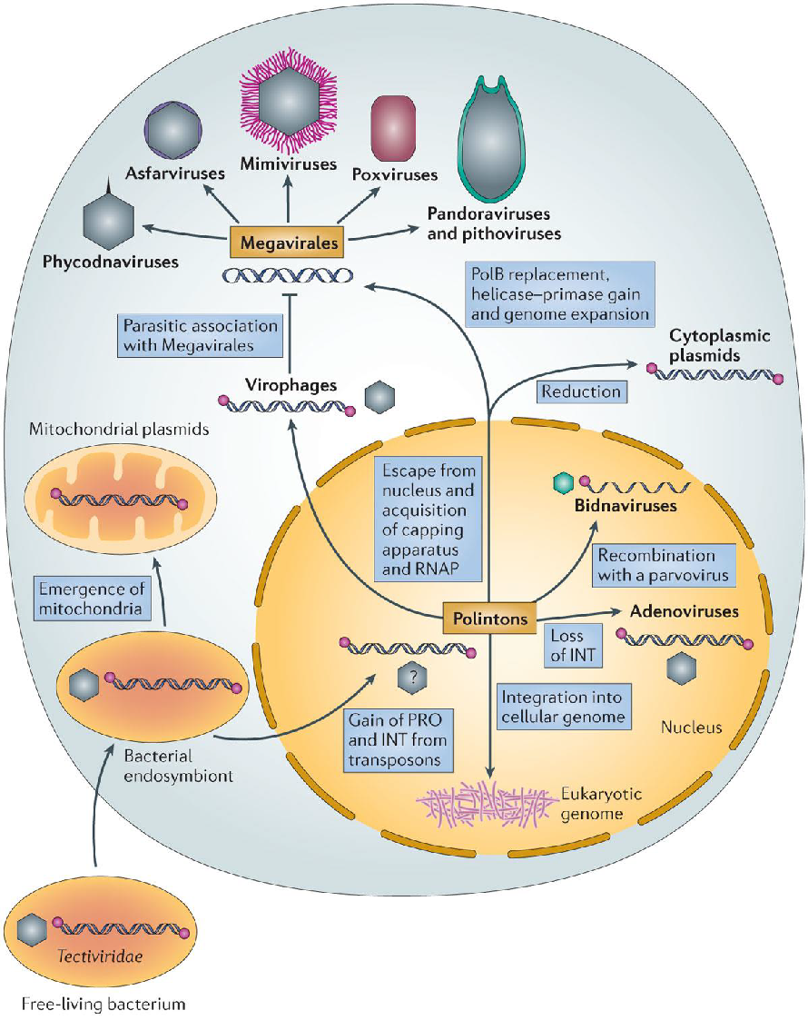
Viral origin of Polintons?
The Polinton genomes are 15–20 kb in size and encode several conserved proteins, including:
protein-primed type B DNA polymerase (pPolB)
retroviral-like (RVE) family integrase
FtsK-like ATPase
adenovirus-type cysteine protease
two putative capsid proteins
Krupovic and Koonin 2015, Nat Rev Micro
Notes:
Polintons have evolved from a linear plasmid that acquired a retroviral integrase at least 1 billion years ago

Slide 30
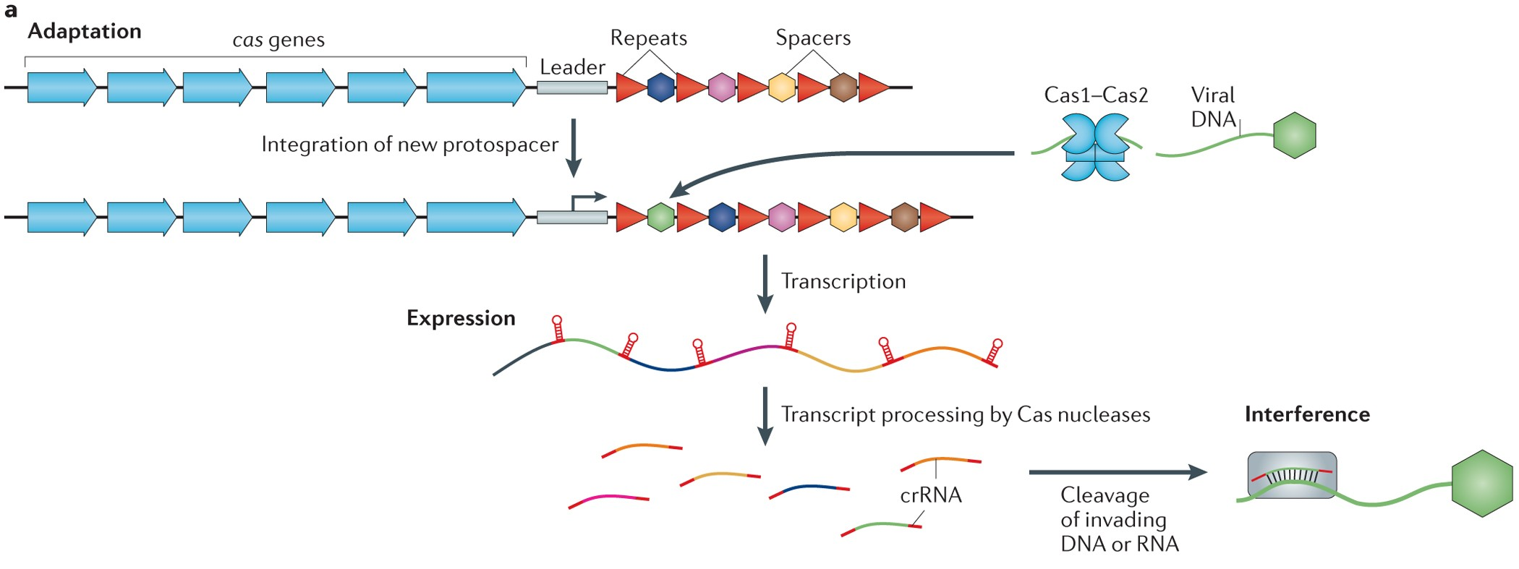
CRISPR-Cas and transposons
a| The prokaryotic clustered regularly interspaced short palindromic repeat–CRISPR-associated protein (CRISPR–Cas) locus consists of cas genes (blue arrows) that encode different Cas proteins, and CRISPR arrays composed of variable spacers (coloured hexagons) interspersed with direct repeats (red triangles). The leader sequence (grey rectangle) contains a promoter for the transcription of the CRISPR array and marks the end where new spacers are incorporated. Three stages of CRISPR–Cas immunity are depicted. During the adaptation stage, a Cas1–Cas2 heterohexamer uptakes a protospacer from the invading plasmid or viral DNA (green) and incorporates it at the leader-proximal end of the CRISPR array. During the expression stage, the CRISPR array is transcribed, and the transcript is processed into small CRISPR RNAs (crRNAs) by different Cas nucleases in a CRISPR–Cas type-dependent manner. During the interference stage, crRNAs act as guides for the cleavage of invading viral or plasmid DNA or RNA that contains regions complementary to the crRNA
Koonin and Krupovic 2015, Nat Rev Genet
Notes:
The prokaryotic clustered regularly interspaced short palindromic repeat–CRISPR-associated protein (CRISPR–Cas) locus consists of cas genes (blue arrows) that encode different Cas proteins, and CRISPR arrays composed of variable spacers (coloured hexagons) interspersed with direct repeats (red triangles). The leader sequence (grey rectangle) contains a promoter for the transcription of the CRISPR array and marks the end where new spacers are incorporated. Three stages of CRISPR–Cas immunity are depicted. During the adaptation stage, a Cas1–Cas2 heterohexamer uptakes a protospacer from the invading plasmid or viral DNA (green) and incorporates it at the leader-proximal end of the CRISPR array. During the expression stage, the CRISPR array is transcribed, and the transcript is processed into small CRISPR RNAs (crRNAs) by different Cas nucleases in a CRISPR–Cas type-dependent manner. During the interference stage, crRNAs act as guides for the cleavage of invading viral or plasmid DNA or RNA that contains regions complementary to the crRNA.

Slide 31
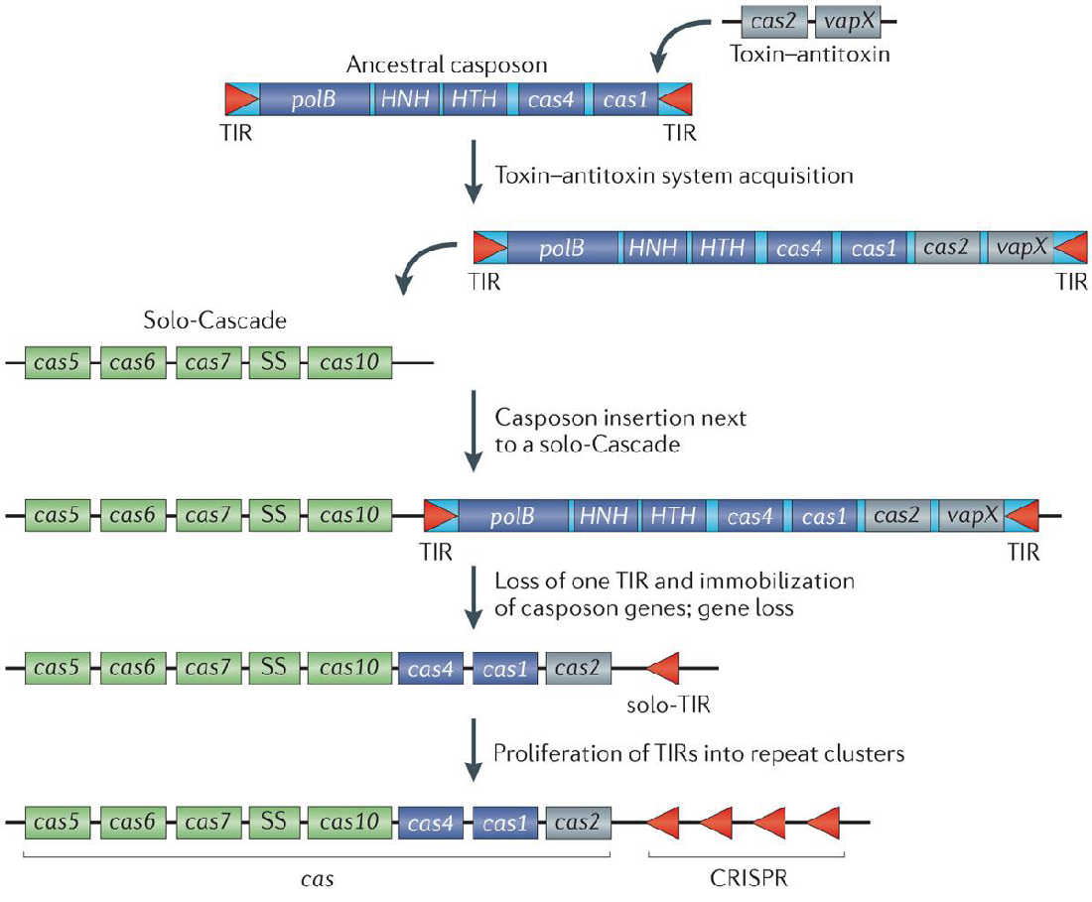
CRISPR-Cas and transposons
Koonin and Krupovic 2015, Nat Rev Genet

Slide 32
TE characteristics so far...
Promoter is necessary
Its integrity is essential!
Encode proteins and recognition motifs for their own mobilization
Transpositions leave signatures in the genome: target site duplications
Their particular mobilization can have different effects on genome evolution:
clustering (target site preferentiality)
trans-mobilization of other mRNAs (e.g., non-autonomous TEs and retrogenes)
trigger of non-allelic homologous (ectopic) recombination
Excision-based transposition can also lead to increased copy number
TEs can originate from viruses and viceversa (e.g., LTR retrotransposons and Polintons)

Slide 33
TEs with Tyrosine Recombinase
TE integration mechanism occurs via:
Endonuclease: LINE, SINE, PLE
DDE-Transposase: TIR
Integrase: LTR, Maverick/Polinton
Rep protein: Helitron
Tyrosine recombinase: DIRS, Crypton
Class I: retrotransposons
Class II: DNA transposons
Wicker et al 2007, Nat Rev Gen

Slide 34
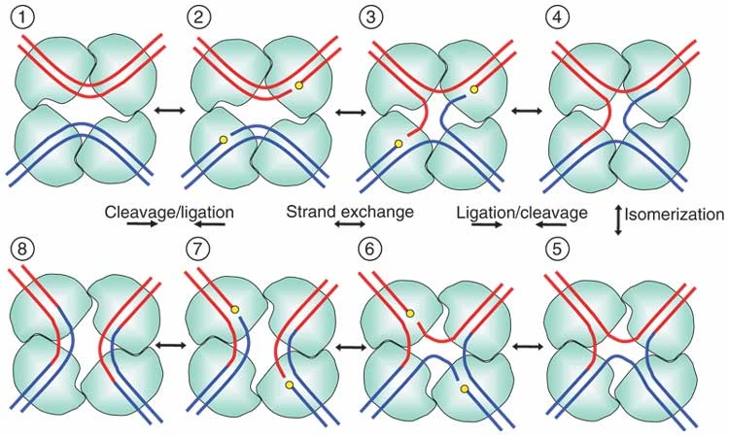
Site-specific recombination
Holliday junction
DIRS and Cryptons have no TSDs (with exceptions)
Rice 2005, Nat Struct Mol Bio

Slide 35
TE characteristics so far...
Promoter is necessary
Backup needed, e.g., LTRs
Encode proteins and recognition motifs for their own mobilization
Transpositions leave signatures in the genome: target site duplications
Their particular mobilization can have different effects on genome evolution:
clustering (target site preferentiality)
trans-mobilization of other mRNAs (e.g., non-autonomous TEs and retrogenes)
trigger of non-allelic homologous (ectopic) recombination
Excision-based transposition can also lead to increased copy number
TEs can originate from viruses and viceversa (e.g., LTR retrotransposons and Polintons)
Human classification of TEs not always can account for complex evolutionary origins

Slide 36
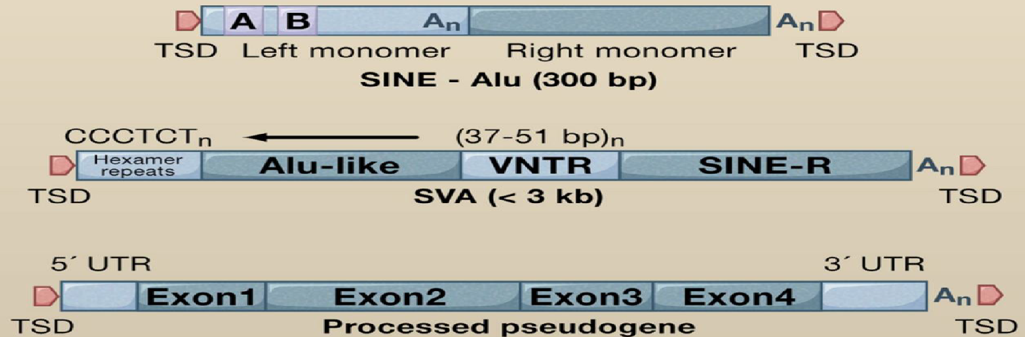
Non-autonomous TEs
Non-LTR retrotransposons

Slide 37
Anything can be a non-autonomous TEs
LTR
PBS
GAG
LTR
PPT
Incomplete ORFs
LTR
PBS
LTR
PPT
LTR retrotransposons
LARDs
Large retrotransposon derivatives
TRIMs
Terminal-repeat
retrotransposons in miniature
LTR
LTR
TIR
TIR
MITE
Miniature inverted-repeat
transposable elements
DNA transposons

Slide 38
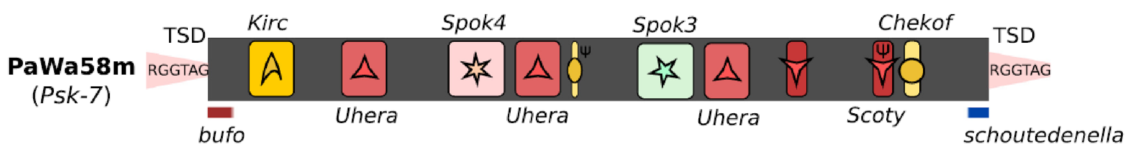
Giant TEs
LTR retrotransposons: Burro(30 kb, planaria Schmidtea mediterranea)
Grohme et al 2018, Nature
TIR DNA transposons: Teratorn(182 kb, medaka Oryzias latipes)
Arkhipova 2019, Genome Biol. Evol.
YR DNA transposons: Enterprise(247 kb, fungus Podospora anserina)
Mobility mechanisms define the upper size limit of TEs
Vogan et al. 2021, Genome Res.

Slide 39
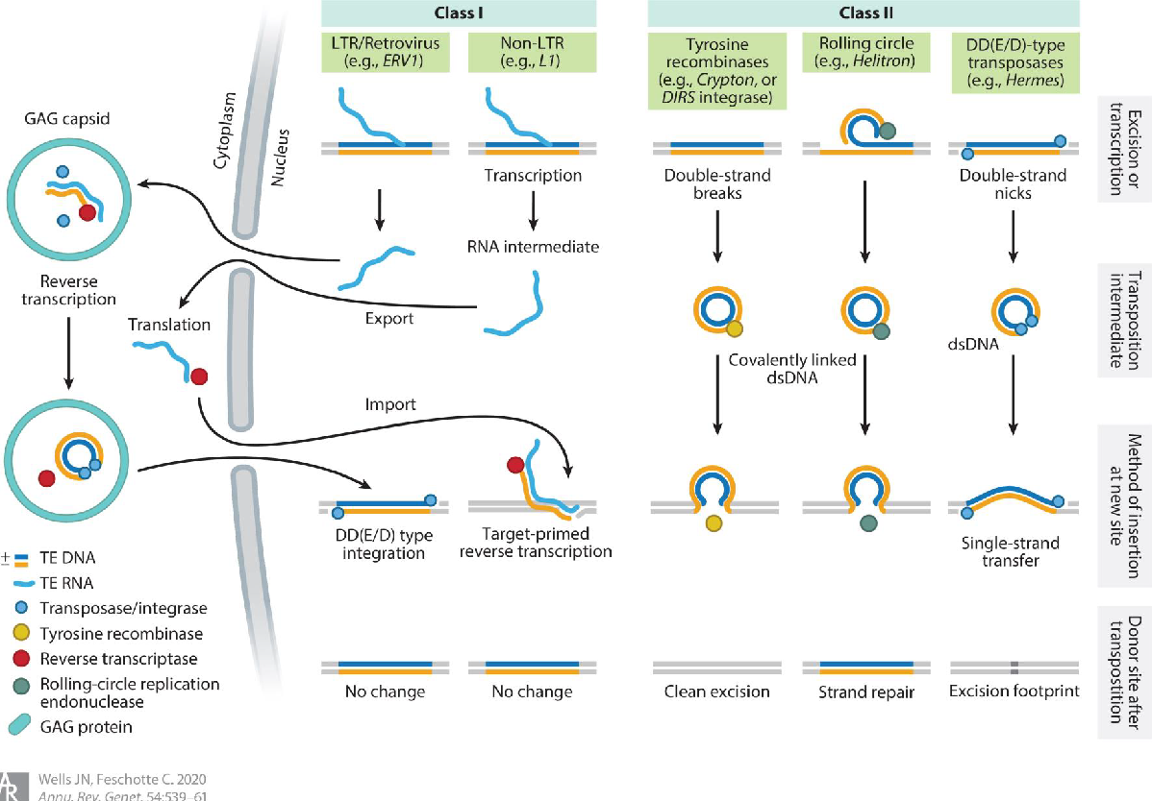
Mechanisms overview
Wells & Feschotte 2020 Annu. Rev. Genet.

Slide 40
TEs are selfish elements
Selfish genetic elements
(anything ranging from single genes or chromosomes to entire genomes)
=
Genetic element with the sole ”purpose” to transmit itself
(which often comes with a cost to its host)
“When a given DNA, or class of DNAs, of unproven phenotypic function can be shown to have evolved a strategy (such as transposition) which ensures its genomic survival, then no other explanation for its existence is necessary. The search for other explanations may prove, if not intellectually sterile, ultimately futile.” According to this theory, the evolutionary success of transposable elements is not attributed to a specific cellular function, as McClintock envisioned, but simply to their ability to replicate independently of the rest of the genome, thereby ensuring their propagation without benefitting the organism, but sometimes at its expense — much like viruses.
Feschotte, C. Transposable elements: McClintock’s legacy revisited. Nat Rev Genet 24, 797–800 (2023). https://doi.org/10.1038/s41576-023-00652-3
Doolittle, W. F. & Sapienza, C. Selfish genes, the phenotype paradigm and genome evolution. Nature 284, 601–603 (1980).

Slide 41
LINE retrotransposons
Where/when/how in the cell
Requirements for mobility
Transcription: promoter for pol II -> mRNA + polyA
Replication: RTase
Recognition site for cis-mobilisation
Integration: endonuclease
No introns
Cytoplasm
Nucleus
LINE mRNA
Ribosome
Master element
RTase
Integration and retrotranscription
RNP
Content of new copies
Mother copy
Daughter copies
Target site preference and TSD
Target site preferentiality for sequences similar to the 3’ UTR
Target site duplications are of variable length
5’ truncation
“dead on arrival”

Slide 42
SINE retrotransposons
Where/when/how in the cell
Requirements for mobility
Transcription: promoter for pol III -> sRNA
Replication + integration: using LINE derived proteins
Recognition site for trans-mobilisation
No introns
Cytoplasm
LINE mRNA
Nucleus
SINE sRNA
Ribosome
Master element
☹
Integration and retrotranscription
Content of new copies
Mother copy
Daughter copies
Target site preference and TSD
Target site preferentiality for sequences similar to the 3’ UTR
Target site duplications are of variable length
5’ truncation
“dead on arrival”

Slide 43
LTR retrotransposons
Where/when/how in the cell
Requirements for mobility
Transcription: promoter for pol II -> mRNA + polyA
Replication: within viral-like particle, gag (capsid), protease, RTase, RNAse H
Integration: integrase
Recognition site for cis-mobilisation (LTR)
No introns
Cytoplasm
Nucleus
LTR mRNA
Ribosome
Integration via integrases
Retrotranscription
Target site preference and TSD
No preferentiality for target site
Specific length of target site duplications (4 bp, 5 or 6 bp)
Content of new copies
Mother copy
Daughter
NAHR
Solo-LTR

Slide 44
DNA transposons (TIR)
Where/when/how in the cell
Requirements for mobility
Transcription: promoter for pol II -> mRNA + polyA
Mobilisation and integration: transposase (Tase)
Replication: dependent on host DNA replication
Recognition site in TIRs allows for both cis- and trans-mobilisation (with different probabilities)
Might have introns
Cytoplasm
Nucleus
DNA mRNA
?
?
Ribosome
Tase
Target site preference and TSD
There can be specificity for target site (e.g., TA, TTAA) and there can be specific target site duplication length (e.g., 8 bp)
Content of new copies
Mother copy
Daughter copy
Inclusion of extra DNA
or loss of ORFs

Slide 45
Group discussion
How do LINE/SINE/LTR/DNA (retro)transposons get transcribed, replicated, and integrated?
Where do these TEs jump, what happens to the new insertion site, and what happens to the new insertion?
What does every new insertion contain or not contain and what consequences does this have for TE and host?
In what state do these TEs show up in the nucleus or cytoplasm and in the transcriptome or proteome?

